Slide 1
Repackaging of Fringe Projector
Design Group 1
ME 4320

Slide 2
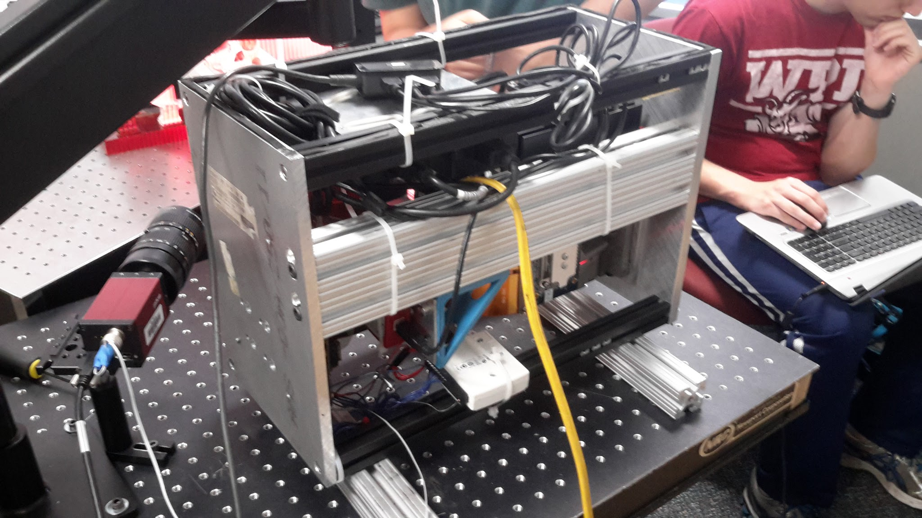
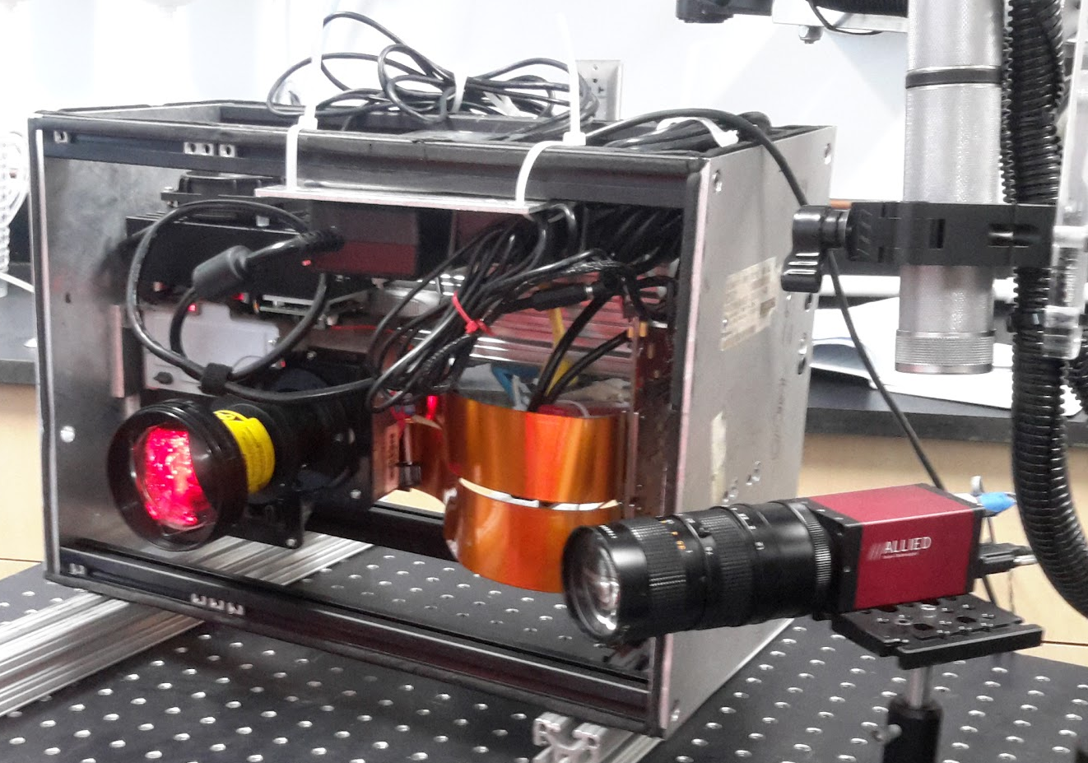
List of components
Side Panels Al 6061 (8”x12”x.375”) = 3.51 lb x 2 = 7.02 lb
Beam Al 8020 Double wide (1.5”x3”x16”) = 3.23 lb
Black 80/20 Al frame beams (1”x1”x16”) = 1.37 lb x 4 = 5.48 lb
Cables, power adapters, wiring = est.6 lb
Fringe Projector (Structured light projection package = 1800 g = 3.97 lb
Total weight = approx. 26.8 lb
Camera = 250 g =.55 lb

Slide 3
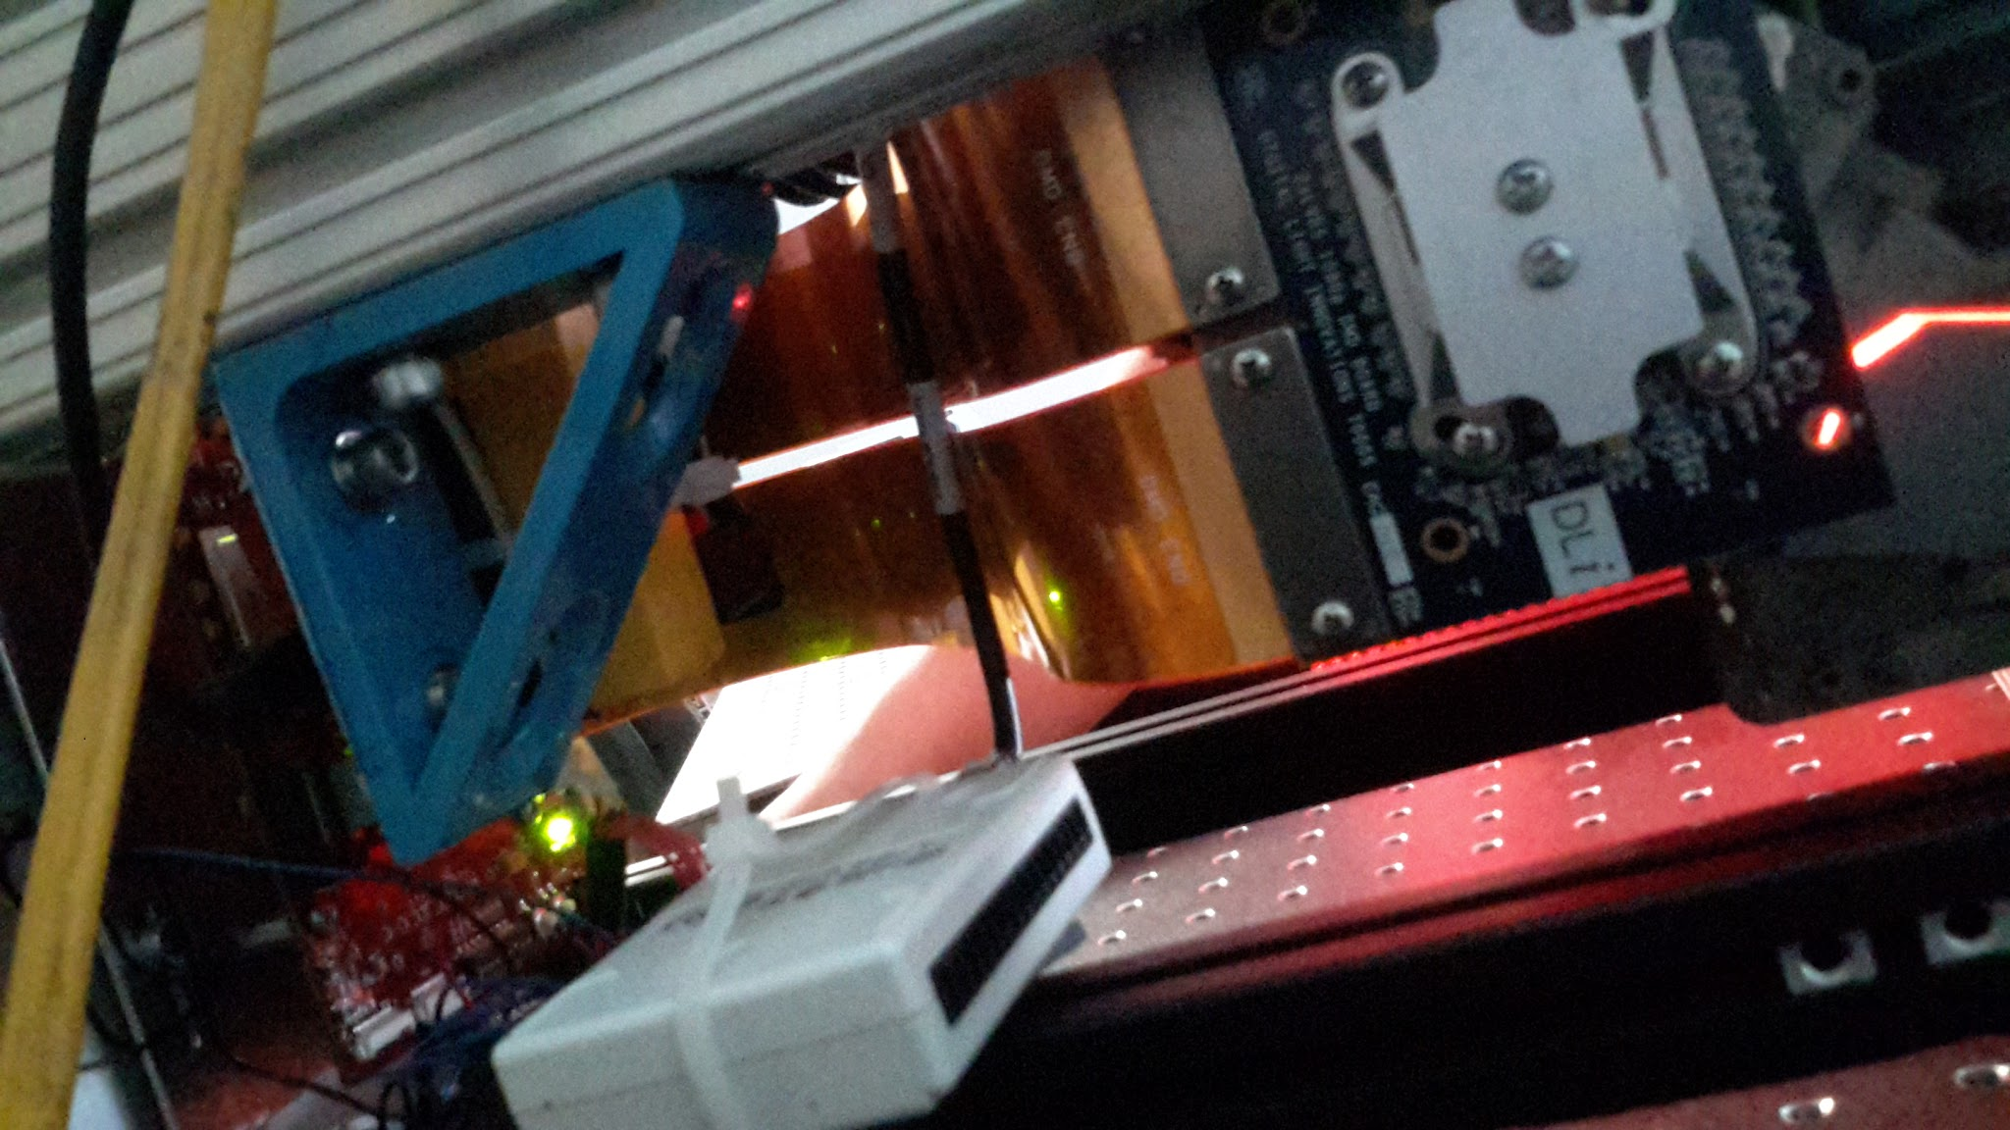
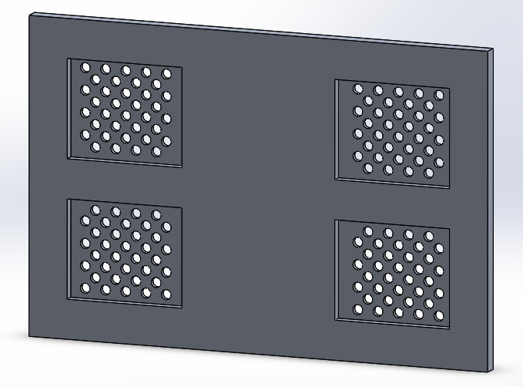
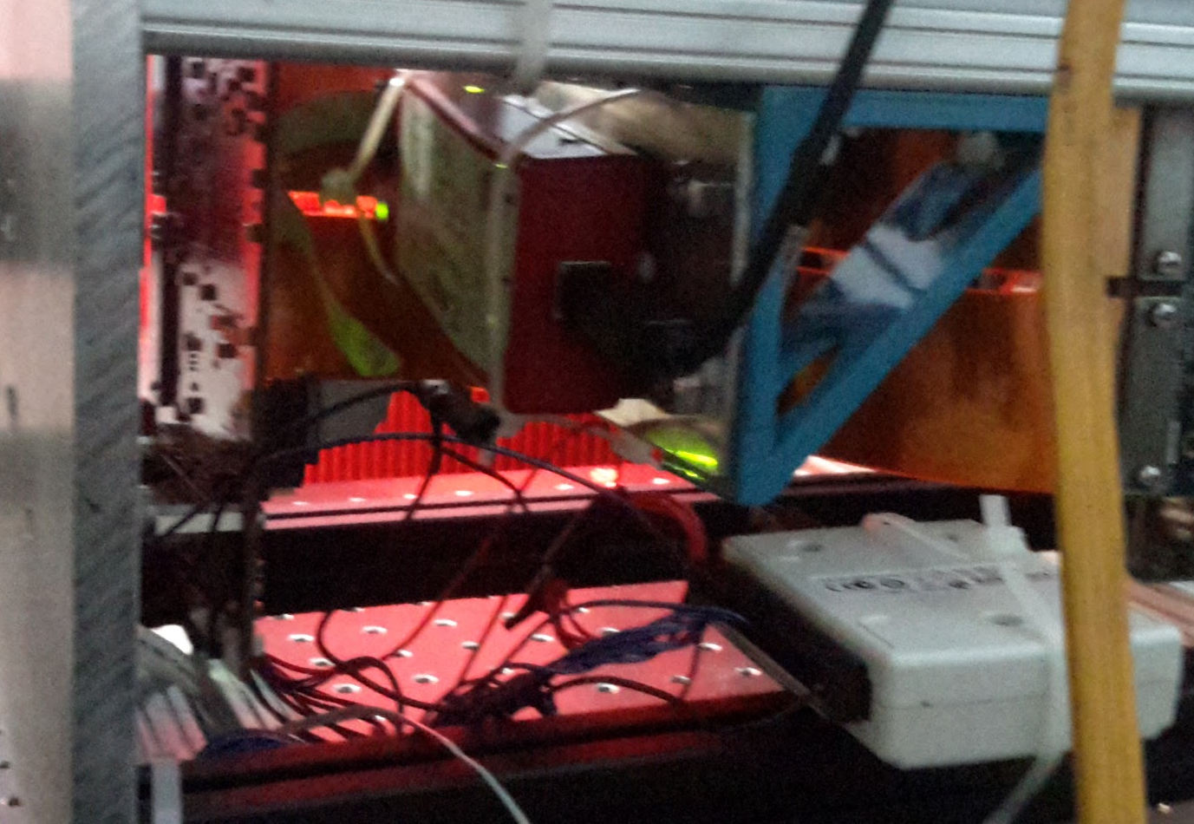
Potential Layout Changes
Weight Reduction
Thinner plates/Milled plates: up to 4.68 lb
Remove double wide 80/20: 3.23 lb
Replace double wide 80/20 with 1” square beam: 1.86 lb

Slide 4

Cable Management
Weight Reduction
Removing/relocating cables: up to 5 lb at end effector

Slide 5
Positioning Camera
Weight Reduction
Adds weight from camera: .55 lb

Slide 6
Potential Added Weight
Handles: .43 lb per handle
Acrylic casing
Top and bottom panels: 2.18 lb per panel .375 thickness, 1.09 lb per panel 3/16” thickness
Back panel: 3.27 lb for .325” thickness, 1.63 lb for 3/16” thickness,
Camera: .55 lb
Sensors: unknown at this point

Slide 7
Overall Estimates
Expect to reduce weight by approximately 5 pounds
Optimistically, 7-8 pounds

Slide 8
Resources
WPI paper on the original packaging - https://www.wpi.edu/Pubs/ETD/Available/etd-082611-133113/unrestricted/Zervas.pdf
Steel handle used - http://www.knobdeals.com/product/391/knob-deals-1110-3-12quot-89mm-steel-bar-pull-satin-nickel?gclid=CM6LwLKA_csCFcNahgodviAGIw

